Slide 1
PHP Functions
Lecture 14

Slide 2
PHP Functions
To keep the script from being executed when the page loads, you can put it into a function.
A function will be executed by a call to the function.
You may call a function from anywhere within a page.

Slide 3
Create a PHP Function
A function is a block of code that can be executed whenever we need it.
Creating PHP functions:
All functions start with the word "function()"
Name the function - It should be possible to understand what the function does by
its name. The name can start with a letter or underscore (not a number)
Add a "{" - The function code starts after the opening curly brace
Insert the function code
Add a "}" - The function is finished by a closing curly brace
Syntax
function functionName() { code to be executed; }
PHP function guidelines:
Give the function a name that reflects what the function does
The function name can start with a letter or underscore (not a number)

Slide 4
Example 1
<html> <body> <?php function writeName() { echo “Saba"; } echo "My name is "; writeName(); ?> </body> </html>

Slide 5
PHP Functions - Return values
Functions can also be used to return values.
<html> <body> <?php function add($x,$y) { $total=$x+$y; return $total; } echo "1 + 16 = " . add(1,16); ?> </body> </html>

Slide 6
PHP Date() Function
The PHP date() function is used to format a time and/or date.
The PHP date() function formats a timestamp to a more readable date and time.
A timestamp is a sequence of characters, denoting the date and/or time at which a certain event occurred.
A timestamp is the number of seconds since January 1, 1970 at 00:00:00 GMT.
Syntax
date(format,timestamp)
Parameter | Description
format | Required. Specifies the format of the timestamp
timestamp | Optional. Specifies a timestamp. Default is the current date and time

Slide 7
time
r : Displays the full date, time and timezone offset. It is equivalent to manually entering date("D, d M Y H:i:s O")
Time:
a: am or pm depending on the time
A: AM or PM depending on the time
g: Hour without leading zeroes. Values are 1 through 12.
G: Hour in 24-hour format without leading zeroes. Values are 0 through 23.
h: Hour with leading zeroes. Values 01 through 12.
H: Hour in 24-hour format with leading zeroes. Values 00 through 23.
i: Minute with leading zeroes. Values 00 through 59.
s: Seconds with leading zeroes. Values 00 through 59.
Syntax: echo date(“h:i:s”);

Slide 8
PHP Date() - Format the Date
The required format parameter in the date() function specifies how to format the date/time.
some characters that can be used:
d - Represents the day of the month (01 to 31)
m - Represents a month (01 to 12)
Y - Represents a year (in four digits)
Other characters, like"/", ".", or "-" can also be inserted between the letters to add additional formatting:
<?php echo date("Y/m/d") . "<br />"; echo date("Y.m.d") . "<br />"; echo date("Y-m-d");
echo date(“h:i:s”); ?>
Time is not according to system time.. WHY

Slide 9
Include Function
The include function takes a file name and simply inserts that file's contents into the script that calls used the include function.
This means that you can type up a common header or menu file that you want all your web pages to include.

Slide 10
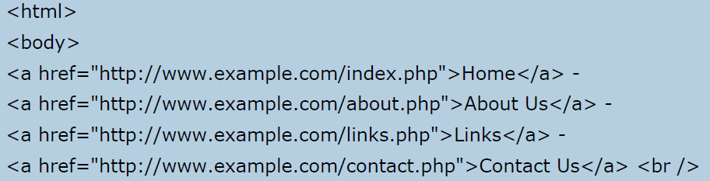
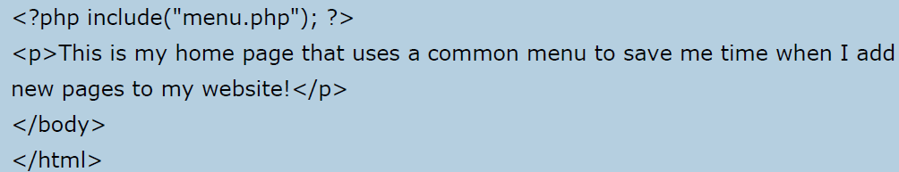
Example 2
Create a file with name “menu.php”
Now create a new file, “index.php”
Output:

Slide 11
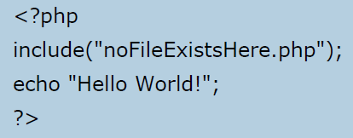
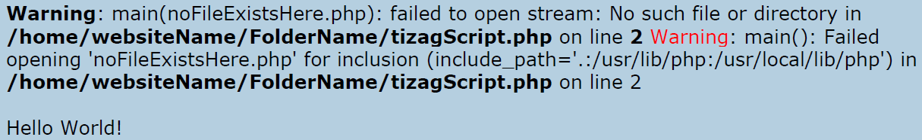
Require Function
The require function is used to include a file into your PHP code. However there is one difference between the two functions .
Require() vs Include()
When you include a file with the include function and PHP cannot find it you will see an error message like the following:
Code:
Output:

Slide 12
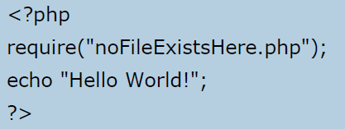
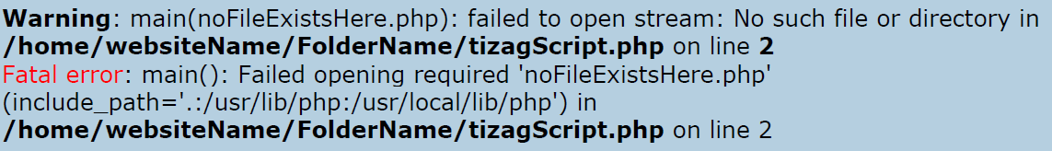
Require() use:
Echo stmt will not be executed:
echo statement was not executed because our script execution died after the require function returned a fatal error!
It is recommend that you use require instead of include because your scripts should not be executing if necessary files are missing or misnamed.

Slide 13
Using Forms with PHP

Slide 14
HTML Forms and PHP
A very common application of PHP is to have an HTML form gather information from a website's visitor and then use PHP to do process that information.
We need to make a simple HTML Form. And data can be get form elements of form. And a separate PHP file.

Slide 15
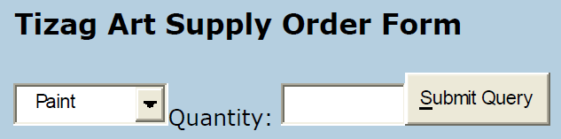

Example 3
An art supply store sells brushes, paint, and erasers.
A form is needed to be designed to get orders (in form of quantity) form customers.
Form should at least have two text fields and a submit button.
Interface:
Output:

Slide 16
Steps
We will create an HTML form "order.html" that have two input fields specified, "item" and "quantity".
We will add two attributes to the form tag to point to "process.php" and set the method to "post".
We will use"process.php" to get the information that would be posted by setting new variables equal to the values in the $_POST associative array.
Finally use the PHP echo function to output the customers order.

Slide 17
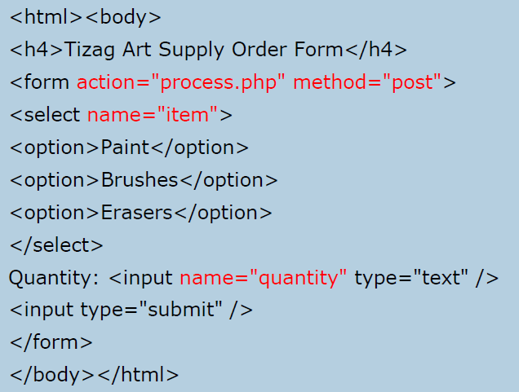
order.html

Slide 18
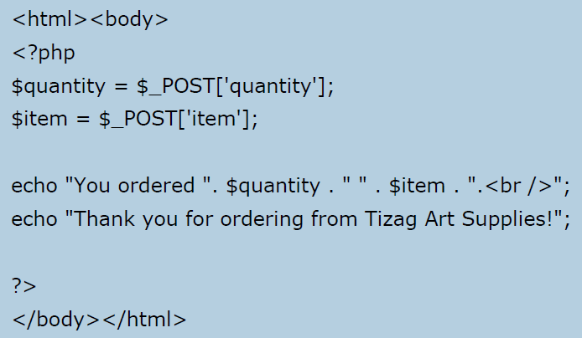
process.php

Slide 19
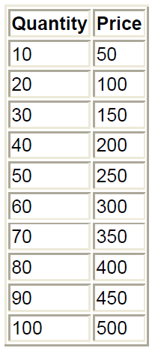
Use of Loops
$brush_price = 5;
$counter = 10;
echo "<table border=\"1\" align=\"center\">";
echo "<tr><th>Quantity</th>";
echo "<th>Price</th></tr>";
while ( $counter <= 100 ) {
echo "<tr><td>";
echo $counter;
echo "</td><td>";
echo $brush_price * $counter;
echo "</td></tr>";
$counter = $counter + 10;
}
echo "</table>";

Slide 20
Assignment 3
Create a form to input following data;
Project name
Team leader
Team Members:
Contact #
Each of info will be stored in table.
Incase of Team Members, no. of rows displayed, will be user dependent. If user says that team members will be 3, then form should create and show 3 rows.

Slide 21
Lab Task 10
Create a form to input following data;
Student name
Father name
Calculus marks :
Web engg marks:
Automata marks:
Total Marks:
%age :
Result:
Each of info will be stored in table.
Incase of Team Members, no. of rows displayed, will be user dependent. If user says that team members will be 3, then form should create and show 3 rows.
Calculate total marks, and percentage using PHP functions. And display them on page.
Based on %age, show the result. If >=50% then Pass. Else Fail.

